Slide 1
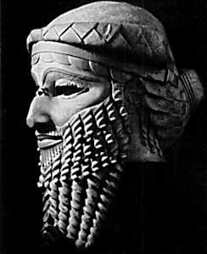
Epic of gilgamesh
“The secret cause of all suffering is mortality itself, which is the prime condition of life. It cannot be denied if life is to be affirmed.”
*Joseph Campbell

Slide 2
Definition of Epic:
“A long narrative poem in elevated style presenting characters of high position in a series of adventures which form an organic whole through their relation to a central figure of heroic proportions and through their development of episodes important to the history of a nation”
YIKES! WHAT THE HECK IS THAT ALL ABOUT?

Slide 3
4 important elements to this definition
1. style: in spite of its folk origins, the epic uses meter and intricate figures of speech. (POETRY)
2. hero: hero is human, but almost superhuman in courage, strength, and greatness of character; savior of nation or race
3. action: great wars; wide ranging over entire continents and even the heavens and “hell”; actions important historically to the nation and race;
4. culture: values of the culture are transmitted
through the epic action and hero.

Slide 4
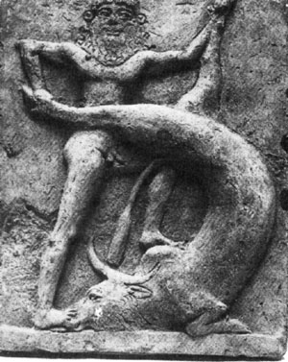
Simpler definition:
Epic: a long, narrative poem about the adventures of a hero that is important both historically and culturally to a nation or race.

Slide 5
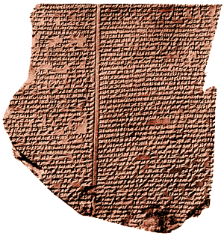
Definition of archetype
“a collectively inherited unconscious idea, pattern of thought, image, etc. universally present in individual psyches”
Archetypes are meaningful to
ALL people; they reveal profound
aspects of human experience,
fundamental facts of our existence:
like birth, growing up, love, death, struggle.

Slide 6
Archetypes:
Archetypal themes: loss of innocence/innocence to experience; death/rebirth; redemption; descent into the abyss; search for identity
Archetypal characters: hero, fool, Don Juan, wise man, femme fatale, traitor, rebel, martyr
Archetypal symbols: snake, lion, eagle, water, fire, garden, trees, light/dark, water/desert

Slide 7
Ontological questions
What are these?
Write down 3 ontological questions:

Slide 8
The Quest – Archetypal plot/theme
This archetypal plot structure takes the hero on a journey which moves him from ignorance to knowledge and/or innocence to experience.
I. Separation or departure
A. call to adventure
B. supernatural aid
C. crossing the threshold

Slide 9
The quest - continued
II. Trials and victories of Initiation
A. trials and dangers
B. Ultimate victory – realization of quest
III. Return to society
Hero regenerates society as a whole physically, morally

Slide 10
About the epic of gilgamesh….
1. 4,000 years old – Sumerian – discovered in 1853
12 surviving tablets.
2. Gilgamesh – “he who saw the abyss”
3. Utnapishtim – “finder of life”
4. Enkidu – Gilgamesh’s trusty sidekick, but not initially – “natural man”
4.Ea – goddess of wisdom
5. Ishtar – Queen of heaven, goddess of love and war

Slide 11
….continued stuff
6. Bull of Heaven/Humbaba – sent by Ishtar, considered by some scholars to be drought, by others to be earthquake
7. Siduri – “young woman” wine maker

Slide 12
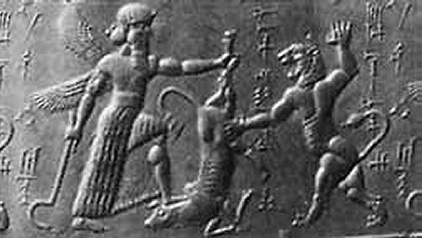

Slide 13
Themes in gilgamesh
What is the relationship between man and god?
What does it mean to be ‘human’?
Does death render life meaningLESS or meaningFULL?
Is there an afterlife and what does it look like?
What is friendship?
What is man’s place in society?

Slide 14
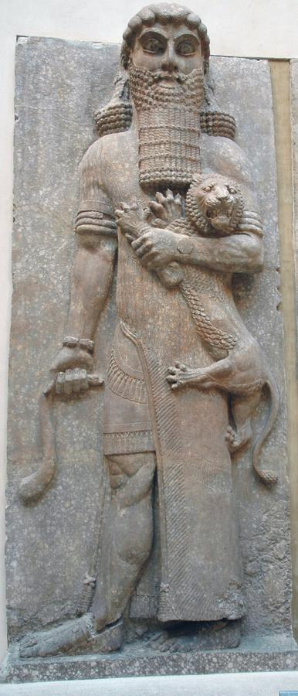
The end

